Slide 1
Chapter 5: Fundamental Operating Systems
IT Essentials: PC Hardware and Software v4.1
Notes:
Cisco Networking Academy Program
IT Essentials: PC Hardware and Software v4.1
Chapter 5: Fundamental Operating Systems

Slide 2
Chapter 5 Objectives
5.1 Explain the purpose of an operating system
5.2 Describe and compare operating systems to include purpose, limitations, and compatibilities
5.3 Determine operating system based on customer needs
5.4 Install an operating system
5.5 Navigate a GUI (Windows)
5.6 Identify and apply common preventive maintenance techniques for operating systems
5.7 Troubleshoot operating systems
Notes:
Chapter 5 Objectives

Slide 3
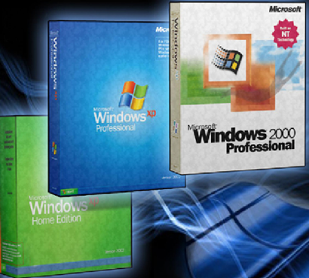
The Purpose of an Operating System
The operating system (OS) controls almost all functions on a computer.
Learn about the components, functions, and terminology related to
the Windows 2000,
Windows XP, and
Windows Vista operating
systems.
Notes:
Chapter Introduction
After completing this chapter, students will meet these objectives:
Explain the purpose of an operating system.
Describe and compare operating systems to include purpose, limitations, and compatibilities.
Determine the operating system based on customer needs.
Install an operating system.
Navigate a GUI.
Identify and apply common preventive maintenance techniques for operating systems.
Troubleshoot operating systems.

Slide 4
Roles of an Operating System
All computers rely on an operating system (OS) to provide the interface for interaction between users, applications, and hardware.
The operating system boots the computer and manages the file system.
Almost all modern operating systems can support more than one user, task, or CPU.
The operating system has four main roles:
    Control hardware access
    Manage files and folders
    Provide user interface
    Manage applications
Notes:
5.1 Explain the purpose of an operating system
Regardless of the size and complexity of the computer and the operating system, all operating systems perform the same four basic functions:
Control hardware access - The operating system manages the interaction between applications and the hardware. To access and communicate with the hardware, the operating system installs a device driver for each hardware component. A device driver is a small program written by the hardware manufacturer and supplied with the hardware component. The process of assigning system resources and installing drivers can be performed with Plug and Play (PnP). The operating system automatically detects the PnP-compatible hardware and installs the driver for that component. The operating system then configures the device and updates the registry, which is a database that contains all the information about the computer.
NOTE: The registry contains information about applications, users, hardware, network settings, and file types.
Files and Folder Management - The operating system creates a file structure on the hard disk drive to allow data to be stored. A file is a block of related data that is given a single name and treated as a single unit. Program and data files are grouped together in a directory. The files and directories are organized for easy retrieval and use. Directories can be kept inside other directories. These nested directories are referred to as subdirectories. Directories are called folders in Windows operating systems, and subdirectories are called subfolders.
User interface - The operating system enables the user to interact with software and hardware. There are two types of user interfaces:
Command Line Interface (CLI) – The user types commands at a prompt.
Graphical User Interface (GUI) – The user interacts with menus and icons.
Most operating systems, such as Windows 2000 and Windows XP, include both a GUI and a CLI.
Application management - The operating system manages all programs to ensure that the correct resources are allocated to the applications. The operating system locates an application and loads it into the RAM of the computer. Applications are software programs, such as word processors, databases, spreadsheets, games, and many other applications. The operating system ensures that each application has adequate system resources. Application programming interface (API) is a set of guidelines used by programmers to ensure that the application they are developing is compatible with an operating system. Here are two examples of APIs:
Open Graphics Library (OpenGL) – Cross-platform standard specification for multimedia graphics
DirectX – Collection of APIs related to multimedia tasks for Microsoft Windows

Slide 5
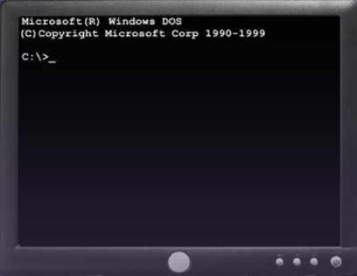
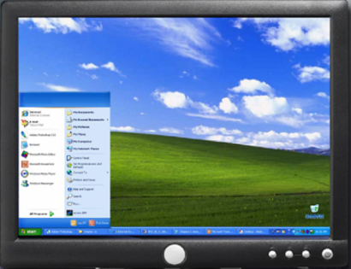
The Types of Operating Systems
Command Line Interface (CLI): The user types commands at a prompt.
Graphical User Interface (GUI): The user interacts with menus and icons.
Most operating systems include both a GUI and a CLI.
Notes:
5.1.1 Describe characteristics of modern operating systems
The operating system enables the user to interact with software and hardware.
There are two types of user interfaces:
Command Line Interface (CLI) – The user types commands at a prompt.
Graphical User Interface (GUI) – The user interacts with menus and icons.
Most operating systems, such as Windows 2000, Windows XP, and Windows Vista include both a GUI and a CLI.

Slide 6
Compare Operating Systems
Terms often used when comparing operating systems:
Multi-user – Two or more users can work with programs and share peripheral devices, such as printers, at the same time.
Multi-tasking – The computer is capable of operating multiple applications at the same time.
Multi-processing – The computer can have two or more central processing units (CPUs) that programs share.
Multi-threading – A program can be broken into smaller parts that can be loaded as needed by the operating system. Multi-threading allows individual programs to be multi-tasked.
Notes:
5.1.2 Explain operating system concepts
Almost all modern operating systems are multi-user and multi-tasking, and they support multi-processing and multi-threading.

Slide 7
CPU Modes of Operation
Real Mode
A CPU that operates in real mode can only execute one program at a time, and it can only address 1 MB of system memory at a time. In real mode, when an application creates an error, the entire computer can be affected because the program has direct access to memory.
Protected Mode
A CPU that operates in protected mode has access to all of the memory in the computer, including virtual memory. In protected mode, applications are protected from using the memory reserved for another application that is currently running.
Notes:
5.1.2 Explain operating system concepts
Real Mode
Executes only one program at a time
Addresses only 1 MB of system memory at a time
Directly accesses memory and hardware
Subject to crashes
Available to all modern processors
Only used by DOS and DOS applications
Protected Mode
Has access to all memory
Can manage multiple programs simultaneously
Allows the system to use virtual memory
Provides 32-bit access to memory, drivers, and I/O transfers
Each program is assigned a space in memory
Computer is protected from program errors

Slide 8
CPU Modes of Operation (Continued)
Virtual Real Mode
A CPU that operates in virtual real mode allows a real-mode application to run within a protected-mode operating system. This can be demonstrated when a DOS application runs in a 32-bit operating system, such as Windows XP.
Compatibility Mode
Compatibility mode creates the environment of an earlier operating system for applications that are not compatible with the current operating system. Compatibility mode can create the proper environment or version of the operating system to allow the application to run as if it is in the intended environment.
Notes:
5.1.2 Explain operating system concepts
Virtual Real Mode
Allows a real-mode application to run within a protected-mode operating system
Creates virtual machines for each program that runs in real mode
Each virtual machine receives 1 MB of memory and access to hardware
In the event of a program error, only the virtual machine is affected
Compatibility Mode
Windows Vista is highly compatible with previous versions of Windows
Two particularly useful features are available
Windows XP Service Pack 2 (SP2) compatibility mode. This allows applications that are not compatible with Windows Vista to be executed as if the operating system were Windows XP SP2.
Override of the User Account Control (UAC).This allows an application to be run even if the user does not have the required administrative privileges.

Slide 9
32-bit vs. 64-bit OS and Processor
32-bit Windows Operating System and x86 Processor Architecture
      Capable of addressing 4 GB of RAM
      Each virtual machine receives 1 MB of memory and access to hardware
      x86 uses a Complex Instruction Set Computer (CISC)
      x86 processors use fewer registers than x64 processors
64-bit Windows Operating System and x64 Processor Architecture
      Capable of addressing 128 GB of RAM
      Enhanced performance for memory management
      Additional security features
      x64 architecture is backward compatible with x86
      Process much more complex instructions at a much higher rate
Notes:
5.1.2 Explain operating system concepts
32-bit vs. 64-bit
There are three main differences between 32-bit and 64-bit operating systems. A 32-bit operating system, such as Windows XP Professional, is capable of addressing only 4 GB of RAM, while a 64-bit operating system can address more than 128 GB of RAM. Memory management is also different between these two types of operating systems, resulting in enhanced performance of 64-bit programs. A 64-bit operating system, such as Windows Vista 64-bit, has additional security features such as Kernel Patch Protection and mandatory Driver Signing. With Kernel Patch Protection, third-party drivers cannot modify the kernel. With mandatory Driver Signing, unsigned drivers cannot be used.
Processor Architecture
There are two common architectures used by CPUs to process data: x86 (32-bit architecture) and x64 (64-bit architecture). x86 uses a Complex Instruction Set Computer (CISC) architecture to process multiple instructions with a single request. Registers are storage areas used by the CPU when performing calculations. x86 processors use fewer registers than x64 processors. x64 architecture is backward compatible with x86 and adds additional registers specifically for instructions that use a 64-bit address space. The additional registers of the x64 architecture allow the computer to process much more complex instructions at a much higher rate.

Slide 10
Compare Operating Systems
Desktop Operating System
Network Operating System
Supports a single user
Runs single-user applications
Shares files and folders
Shares peripherals
Used on a small network
Supports multiple users
Runs multi-user applications
Is robust and redundant
Provides increased security
Used on a network
Notes:
5.2 Describe and compare operating systems to include purpose, limitations, and compatibilities
There are two distinct types of operating systems: desktop operating systems and network operating systems. A desktop operating system is intended for use in a small office/home office (SOHO) with a limited number of users. A network operating system (NOS) is designed for a corporate environment serving multiple users with a wide range of needs.

Slide 11
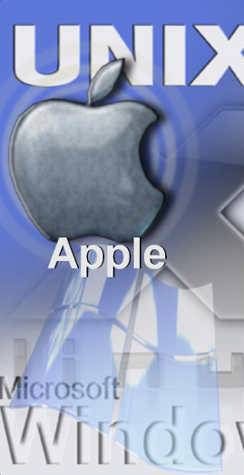
Compare Operating Systems
Desktop operating systems:
      Microsoft Windows: Windows XP
      Macintosh: Mac OS X
      Linux
      UNIX
A desktop OS has the following characteristics:
      Supports a single user
      Runs single-user applications
      Shares files and folders on a small network with limited security
Notes:
5.2.1 Describe desktop operating systems
The differences between desktop operating systems are typically related to availability and how much can be accomplished using the GUI:
Windows and MAC OS users can perform the majority of tasks through the GUI.
Linux and UNIX users must understand and use the CLI to perform some tasks.
The code for an operating system will be either open source or proprietary:
Open source applications can be read and modified. There are few restrictions on downloading, using, or rewriting open source software. Programmers openly share code with other programmers. Linux distributions are open source.
Proprietary applications cannot be read or modified. Proprietary software agreements restrict the use of the software, identifying where and when the software may be used. Microsoft Windows products are proprietary.
NOTE: In this course, all command paths refer to Windows XP unless otherwise noted.

Slide 12
Network Operating Systems (NOS)
Common NOS include:
      Novell Netware
      Microsoft Windows Server
      Linux
      UNIX
NOS has the following characteristics:
      Supports multiple users
      Runs multi-user applications
      Is robust and redundant
      Provides increased security compared to desktop operating systems
Notes:
5.2.2 Describe network operating systems
Microsoft Windows – Network operating systems offered by Microsoft are Windows 2000 Server, Windows Server 2003, and Windows Server 2008. Windows Server operating systems use a central database called Active Directory to manage network resources.
Novell Netware – Novell NetWare was the first OS to meet network OS requirements and enjoy widespread deployment in PC-based LANs back in the 1980s.
Linux – Linux operating systems include Red Hat, Caldera, SuSE, Debian, Fedora, Ubuntu and Slackware.
UNIX – Various corporations offered proprietary operating systems, based on UNIX
Student Activity: The student course content includes worksheet, 5.2.2 NOS Certifications and Jobs. To complete this worksheet, students will conduct research for three different network operating system certifications. Record the details of each, including Network Operating Systems covered, certification titles, and courses and/or training required to earn certification. Then the students will conduct research for at least two network jobs available in your area. Describe the network jobs and the required certifications needed for the position. Which job would you prefer? List reasons for your selection.

Slide 13

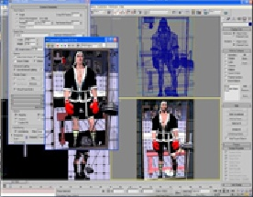
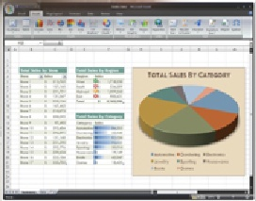
Determine Proper Operating System
To select the proper operating system:
Create an accurate profile of your customer by analyzing the daily, weekly, and monthly computer activities
Select appropriate software and hardware to satisfy existing and future requirements
Notes:
5.3 Determine operating system based on customer needs
After completing this section, students will meet these objectives:
Identify applications and environments that are compatible with an operating system.
Determine minimum hardware requirements and compatibility with the OS platform

Slide 14
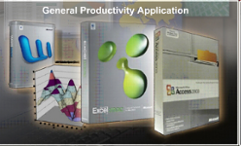

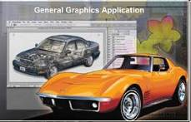
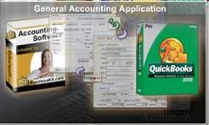
What Does Your Customer Require?
Office applications
  Word processing, spreadsheets, or presentation software
Graphics applications
  Photoshop or Illustrator
Animation applications
  Flash
Business applications
  Accounting, contact management, sales tracking or database
Notes:
5.3.1 Identify applications and environments that are compatible with an operating system
An operating system should be compatible with all applications that are installed on a computer. Before recommending an OS to your customer, investigate the types of applications that your customer will be using. If the computer will be part of a network, the operating system must also be compatible with the operating systems of the other computers in the network. The network type determines what operating systems are compatible. Microsoft Windows networks can have multiple computers using different versions of Microsoft operating systems.

Slide 15

Identify Minimum Hardware Requirements
Customer may need to upgrade or purchase additional hardware to support the required applications and OS.
A cost analysis will indicate if purchasing new equipment is a better idea than upgrading.
Common hardware upgrades:
  RAM capacity
  Hard drive size
  Processor speed
  Video card memory and speed
Notes:
5.3.2 Determine minimum hardware requirements and compatibility with the OS platform
Operating systems have minimum hardware requirements that must be met for the OS to install and function correctly.
Identify the equipment that your customer has in place. If hardware upgrades are necessary to meet the minimum requirements for an OS, conduct a cost analysis to determine the best course of action. In some cases, it may be less expensive for the customer to purchase a new computer than to upgrade the current system.
NOTE: In some cases, the application requirements may exceed the hardware requirements of the operating system. For the application to function properly, it will be necessary to satisfy the additional requirements.
Once you have determined the minimum hardware requirements for an OS, you should ensure that all of the hardware in the computer is compatible with the operating system that you have selected for your customer.

Slide 16
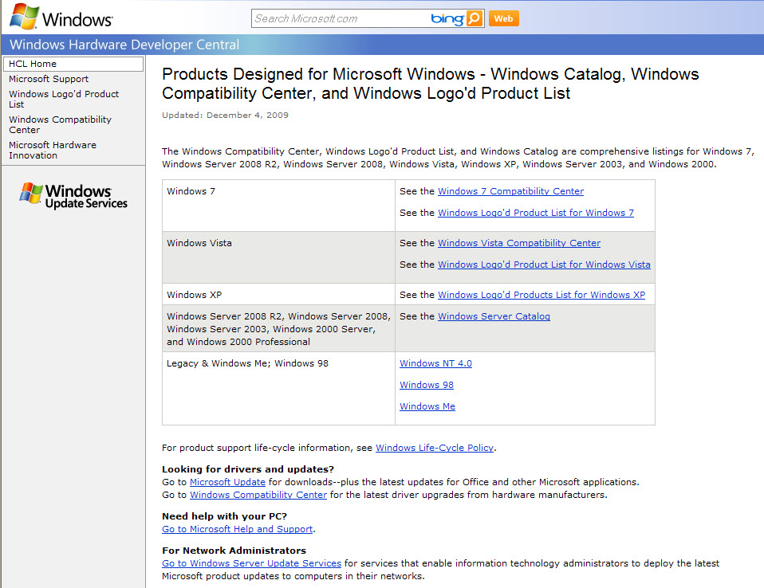
Hardware Compatibility List (HCL)
Most operating systems have an HCL.
HCLs can be found on the manufacturer's website.
HCL includes list of hardware that is known to work with the operating system.
Notes:
5.3.2 Determine minimum hardware requirements and compatibility with the OS platform
NOTE: An HCL may not be continuously maintained and therefore may not be a comprehensive reference.
Student Activity: The student course content includes the worksheet, 5.3.2 Upgrade Components. To complete this worksheet, students will conduct research for specified hardware components including RAM, hard disk drive, and video adapter card. Find the details of at least two of each component specified including brand name, model number, features, and cost. Recommend one of each for purchase.

Slide 17
Installing the Operating System
Reasons to perform a clean installation of an OS:
  When a computer is passed from one employee to another
  When the operating system is corrupted
  When a new replacement hard drive is installed in a computer
Before performing a clean installation:
  Back up all data first
  Explain to the customer that existing data will be erased
  Confirm that all needed data has been successfully transferred
Notes:
5.4 Install an operating system
NOTE: When you perform a clean install on an existing computer, you should back up all data first. You should also explain to the customer that existing data will be erased. As an extra precaution, some businesses hold the computer for a period of time to guarantee that all needed information has been successfully transferred before carrying out the clean install.
After completing this section, students will meet these objectives:
Identify hard drive setup procedures
Prepare the hard drive
Install the operating system using default settings
Create user accounts
Complete the installation
Describe custom installation options
Identify the boot sequence files and Registry files
Describe how to manipulate operating system files
Describe directory structures

Slide 18
Hard Drive Setup Procedures
Operating system setup methods:
  Install an OS over a network from a server
  Install from a copy of the OS files stored on the hard drive
  Install from OS files stored on CDs or DVDs
Notes:
5.4.1 Identify hard drive setup procedures
The installation and initial booting of the operating system is called the operating system setup. Although it is possible to install an operating system over a network from a server or from a local hard drive, the most common installation method is with CDs and DVDs. To install an OS from a CD or DVD, first configure the BIOS setup to boot the system from the CD or DVD.
Before installing an operating system on a hard drive, the hard drive must be partitioned and formatted. When a hard drive is partitioned, it is logically divided into one or more areas. When a hard drive is formatted, the partitions are prepared to hold files and applications. During the installation phase, most operating systems automatically partition and format the hard drive. A technician should understand the process relating to hard drive setup

Slide 19
Hard Drive Setup Procedures (Continued)
Partitioning and Formatting
Hard drive must be logically divided (partitioned)
File system must be created on the hard drive
During the installation phase, most operating systems will automatically partition and format the hard drive
Notes:
5.4.1 Identify hard drive setup procedures
Primary partition – This partition is usually the first partition. A primary partition cannot be subdivided into smaller sections. There can be up to four partitions per hard drive.
Active partition – This partition is the partition used by the operating system to boot the computer. Only one primary partition can be marked active.
Extended partition – This partition normally uses the remaining free space on a hard drive or takes the place of a primary partition. There can be only one extended partition per hard drive, and it can be subdivided into smaller sections called logical drives.
Logical drive – This drive is a section of an extended partition that can be used to separate information for administrative purposes.
Formatting – This process prepares a file system in a partition for files to be stored.
Cluster – A cluster is also called a file allocation unit. It is the smallest unit of space used for storing data.
Track – A track is one complete circle of data on one side of a hard drive platter. A track is broken into groups of 512 bytes, called sectors.
Cylinder – A cylinder is a stack of tracks lined up one on top of another to form a cylinder shape.
Drive mapping – Drive mapping is a letter assigned to a physical or logical drive.

Slide 20
Prepare the Hard Drive
The first portion of the installation process deals with formatting and partitioning the hard drive.
The second portion prepares the disk to accept the file system.
The file system provides the directory structure that organizes the user's operating system, application, configuration, and data files.
Examples of file systems:
  The FAT32 file system
  The New Technology File System (NTFS)
Notes:
5.4.2 Prepare hard drive
The disk must first be partitioned and formatted. This is similar to preparing a large garden plot. Partitioning is similar to laying out footpaths and ditches for irrigation and drainage. This defines the size and shape of your garden. Formatting is similar to laying out rows or beds. These are sized according to the crops that you wish to plant.
The Windows XP operating system can use one of two formats:
The FAT32 file system records the position of files on the disk using File Allocation Tables and 32-bit addressing (FAT32).
The New Technology File System (NTFS) uses a journaling system to record changes to the file system and a Master File Table (MFT) to record information about each file. NTFS is usually more reliable than FAT32 and incorporates security.
Student Activity: The student course content includes two labs:
5.4.2 Install Windows XP. To complete this lab, students will install the Windows XP using FAT32 on a 5 GB partition. The following equipment is required for this exercise; A computer with a blank hard disk drive and Windows XP Professional installation CD.
5.4.2 Install Windows Vista. To complete this lab, students will install the Windows Vista using a 20 GB partition. The following equipment is required for this exercise; A computer with a blank hard disk drive and Windows Vista Business installation DVD.

Slide 21
Install the Operating System
When a computer boots up with the Windows installation CD, the Windows XP installation process starts with three options:
Setup XP: To run the setup and install the XP operating system, press ENTER.
Repair XP: To repair an installation, press R to open the Recovery Console. The Recovery Console is a troubleshooting tool. It can be used to create and format partitions and repair the boot sector or Master Boot Record. It can also perform basic file operations on operating system files and folders. The Recovery Console configures services and devices to start or not start the next time the computer boots up.
Quit: To quit Setup without installing Windows XP, press F3.
Notes:
5.4.3 Install the operating system using default settings
Windows setup searches for existing Windows installations. If no existing installation is found, you can perform a clean installation of Windows. If an existing installation is found, you have the option of performing a repair installation. A repair installation fixes the current installation using the original files from the Windows XP installation disc. Before performing a repair installation, back up any important files to a different physical location such as a second hard drive, CD, or USB storage device.
When a computer boots up with the Windows Vista installation disc, Windows Vista installation starts with three options:
Upgrade – Keep your files, settings, and programs and upgrade Windows. Also use this option to repair an installation.
Custom (advanced) – Install a clean copy of Windows, select where you want to install it, or make changes to disks and partitions.
Quit – To quit Setup, click the x in the Close box.
If no existing Windows installations are found, the Upgrade option is disabled.

Slide 22
Create Administrator Account
Setup creates the administrator account with the user name “administrator”
  Change this name to keep the administrator account secure
  Only use the administrator account occasionally for critical system changes
Create a fictitious user account to use as a template
Use secure passwords
  These should be a minimum of 7 characters, containing at least one of each (letter, number, and symbol)
Notes:
5.4.4 Create accounts
An administrator account is automatically created when Windows XP is installed. This privileged account should only be used to manage the computer. It should not be used as a daily account.
Create a user account when prompted during the installation process Unlike the administrator account, user accounts can be created at any time. A user account has fewer permissions than the computer administrator.

Slide 23
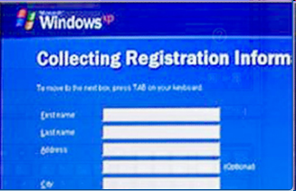
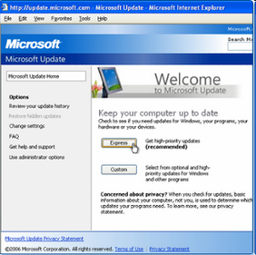
Complete the Installation
When Windows XP installation completes:
  Computer will reboot
  Log in for the first time
  Register Windows XP and verify that you are using a legal copy of the OS
  Verification enables you to download patches and service packs
Use Microsoft Update Manager to scan for new software
Notes:
5.4.5 Complete the installation
You must register Windows XP. You must also complete the verification that ensures that you are using a legal copy of the OS. Doing so will enable you to download patches and service packs. Performing this step requires a connection to the Internet.
Depending on the age of the media at the time of your installation, there may be updates to install. You can use the Microsoft Update Manager from the Start menu to scan for new software and to do the following:
Install all service packs
Install all patches
You should also verify that all hardware is installed correctly. You can use Device Manager to locate problems and to install the correct or updated drivers using the following path: Start > Control Panel > System > Hardware > Device Manager
In Device Manager, warning icons are represented by a yellow exclamation point or a red “X”. A yellow exclamation point represents a problem with the device.
Student Activity: The student course content includes two labs:
5.4.5 Lab: Creating Accounts and Checking For Updates in Windows XP. To complete this lab, students will create user accounts and configure the operating system for automatic updates after the Windows XP Professional installation process. The following equipment is required for this exercise; A computer with a new installation of Windows XP Professional.
5.4.5 Lab: Creating Accounts and Checking For Updates in Windows XP. To complete this lab, students will create user accounts and configure the operating system for automatic updates after the Windows Vista Business installation process. The following equipment is required for this exercise; A computer with a new installation of Windows Vista Business.
Note: The Windows Vista labs include information covered in the CompTIA A+ certification and IT Essentials course chapter and final exams. These labs must be completed to prepare for the certification and course chapter and final exams. If the class does not have access to the Windows Vista operating system and compatible computer equipment, students must complete the labs using the provided screenshots.

Slide 24
Custom Installation Options – Disk Cloning
With Microsoft System Preparation
Follow these steps for disk cloning:
  Create a master installation on one computer
  Run Sysprep
  Create a disk image of the configured computer using third-party disk-cloning software
  Copy the disk image onto a server
When the destination computer is booted,
  A shortened version of the Windows setup program runs
  Setup configures only user-specific and computer-specific settings
  An answer file provides data normally required during set up
Notes:
5.4.6 Describe custom installation options
You can use the Microsoft System Preparation (Sysprep) tool to install and configure the same operating system on multiple computers. Sysprep prepares an operating system that will be used on computers with different hardware configurations. With Sysprep and a disk cloning application, technicians are able to quickly install an operating system, complete the last configuration steps for the OS setup, and install applications.
Disk Cloning creates an image of a hard drive in a computer.

Slide 25
Custom Installation Options – Network Install
With a copy of the installation files - I386 folder
Follow these steps for disk cloning:
  Create a bootable partition on the computer.
  Copy the installation files (I386 folder from the installation disc) to a shared directory on the network server.
  Boot the computer with a boot disk that contains a network client and connect to the shared directory.
  From the shared directory, run the setup program, WINNT.EXE.
  The setup program copies all installation files from the network share onto the computer hard drive.
  Installation continues much the same as if the installation were performed from a disc.
Notes:
5.4.6 Describe custom installation options
Network Installation
Prepare the computer by creating a FAT or FAT32 partition of at least 1.5 GB. You must also make the partition bootable and include a network client. You can also use a boot disk that contains a network client so that the computer can connect to a file server over the network.
Recovery Disc
You can use a recovery disc when there has been a system failure and other recovery options have failed, such as booting in Safe Mode or booting a Last Known Good. An Automated System Recovery (ASR) set must be created before a recovery can be performed. Use the ASR Wizard in Backup to create the ASR set
Factory Recovery Partition
Some computers that have Windows XP pre-installed from the factory contain a section of disk that is inaccessible to the user. This partition on the disk contains an image of the bootable partition, created when the computer was built. This partition is called a factory recovery partition and can be used to restore the computer to its original configuration

Slide 26
The Boot Sequence for Windows XP
Power On Self Test (POST)
POST for each adapter card that has a BIOS
BIOS reads the Master Boot Record (MBR)
MBR takes over control of the boot process and starts NT Loader (NTLDR)
NTLDR reads the BOOT.INI file to know which OS to load and where to find the OS on the boot partition
NTLDR uses NTDETECT.COM to detect any installed hardware
NTLDR loads the NTOSKRNL.EXE file and HAL.DLL
NTLDR reads the registry files and loads device drivers
NTOSKRNL.EXE starts the WINLOGON.EXE program and displays the Windows login screen
Notes:
5.4.7 Identify the boot sequence files and Registry files
You should know the process that Windows XP uses when booting. Understanding these steps can help you to troubleshoot boot problems.
The Windows XP Boot Process
To begin the boot process, you first turn on the computer, which is called a cold boot. The computer performs the Power On Self Test (POST). Because the video adapter has not yet been initialized, any errors that occur at this point in the boot process are reported by a series of audible tones, called beep codes.
After POST, the BIOS locates and reads the configuration settings that are stored in the CMOS. This configuration setting, called the boot device priority, is the order in which devices are checked to see if an operating system is located there. The boot device priority is set in the BIOS and can be arranged in any order. The BIOS boots the computer using the first drive that contains an operating system.
When the drive with the operating system is located, the BIOS locates the Master Boot Record (MBR). The MBR locates the operating system boot loader. For Windows XP, the boot loader is called NT Loader (NTLDR).
If more than one OS is present on the disk, BOOT.INI gives the user a chance to select which to use.

Slide 27
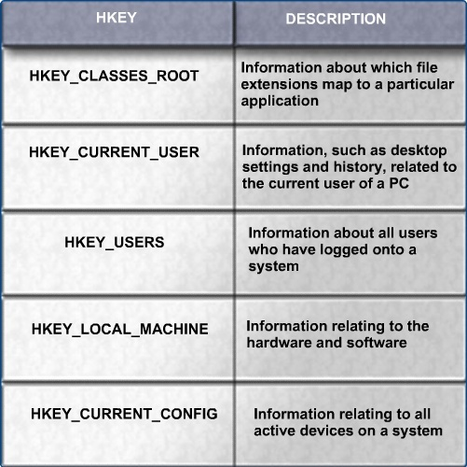
The Windows Registry Files
Notes:
5.4.7 Identify the boot sequence files and Registry files
The Windows Registry files are an important part of the Windows XP boot process. These files are recognized by their distinctive names, which begin with HKEY_ followed by the name of the portion of the operating system under their control.
Every setting in Windows—from the background of the desktop and the color of the screen buttons to the licensing of applications—is stored in the Registry.
Each user has a unique section of the Registry. The Windows login process pulls system settings from the Registry to reconfigure the system to the state that it was in the last time that you turned it on.
Next, the NT kernel, NTOSKRNL.EXE, takes over
It starts the login file, WINLOGON.EXE
That program starts the Local Security Administration file, LSASS.EXE (Local Security Administration)

Slide 28
Manipulating Operating System Files
Msconfig: This boot configuration utility allows you to set the programs that will run at startup and to edit configuration files.
Regedit: This application allows users to edit the registry.
Msinfo32 – This utility displays a complete system summary of your computer including hardware components and details, and installed software and settings.
Dxdiag – This utility shows details about all of the DirectX components and drivers that are installed in your computer.
Cmd – This command opens a command window when it is entered in the Run… box. This is used to execute command line programs and utilities.
Notes:
5.4.8 Describe how to manipulate operating system files
The registry is a database that contains information and settings for all of the hardware, software, users and preferences. REGEDIT allows users to edit the registry.
Msinfo32 utility provides a complete system summary of computer hardware and software
Dxdiag utility shows details of DirectX components and driver, and is used to ensure that DirectX is installed properly and configured correctly

Slide 29
Manipulating Operating System Files (Continued)
Pressing the F8 key during the boot process opens the Windows Advanced Startup Options menu, which allows you to select how to boot Windows.
Safe Mode – Starts Windows but only loads drivers for basic components, such as the keyboard and display.
Safe Mode with Networking Support – Starts Windows identically to Safe Mode and also loads the drivers for network components.
Safe Mode with Command Prompt – Starts Windows and loads the command prompt instead of the GUI interface.
Last Known Good Configuration – Enables a user to load the configurations settings of Windows that was used the last time that Windows successfully started. It does this by accessing a copy of the registry that is created for this purpose.
Notes:
5.4.8 Describe how to manipulate operating system files
You can boot Windows in one of many different modes. Pressing the F8 key during the boot process opens the Windows Advanced Startup Options menu, which allows you to select how to boot Windows.
Student Activity: The student course content includes two labs:
5.4.8 Lab: Managing System Files with Built-in Utilities in Windows XP. To complete this lab, students will use Windows built-in utilities to troubleshoot system resources, and to export and import registry settings. The following equipment is required for this exercise; a computer system running Windows XP.
5.4.8 Lab: Managing System Files with Built-in Utilities in Windows Vista. To complete this lab, students will use Windows built-in utilities to troubleshoot system resources, and to export and import registry settings. The following equipment is required for this exercise; a computer system running Windows Vista.
Note: The Windows Vista labs include information covered in the CompTIA A+ certification and IT Essentials course chapter and final exams. These labs must be completed to prepare for the certification and course chapter and final exams. If the class does not have access to the Windows Vista operating system and compatible computer equipment, students must complete the labs using the provided screenshots.

Slide 30
Describing Directory Structures
Windows file system naming conventions:
  Maximum of 255 characters may be used
  Characters such as a period (.) or a slash (\ /) are not allowed
  An extension of three or four letters is added to the filename to identify the file type
  Filenames are not case sensitive
Windows filename extension examples:
  .doc - Microsoft Word
  .txt - ASCII text only
  .jpg - graphics format
  .ppt - Microsoft PowerPoint
  .zip - compression format
Notes:
5.4.9 Describe directory structures
In Windows, files are organized in a directory structure. The root level of the Windows partition is usually labeled drive C:\. Next, there is an initial set of standardized directories, called folders, for the operating system, applications, configuration information, and data files. Following the initial installation, users can install most applications and data in whatever directory they choose.
The directory structure maintains a set of attributes for each file that controls how the file may be viewed or altered. The following are the most common file attributes:
R - The file is read-only.
A - The file will be archived the next time that the disk is backed up.
S - The file is marked as a system file and a warning is given if an attempt is made to delete or modify the file.
H - The file is hidden in the directory display.

Slide 31
NTFS and FAT32
FAT32 is used where files need to be accessed by multiple versions of Windows. FAT32 is not as secure as NTFS
NTFS can support more and larger files than FAT32, and provides more flexible security features for folders, files, and sizes
Partitions can be converted from FAT32 to NTFS using the CONVERT.EXE utility, but not in the reverse direction
Notes:
5.4.9 Describe directory structures
Windows XP and Windows 2000 use FAT32 and NTFS, while Windows Vista uses NTFS file systems. Security is one of the most important differences between these file systems. NTFS can support more and larger files than FAT32 and provides more flexible security features for files and folders.
Partitions can be converted from FAT32 to NTFS using the CONVERT.EXE utility. Doing this will provide the extra security advantages of NTFS. To restore an NTFS partition back to a FAT32 partition, reformat the partition and restore the data from a backup.
CAUTION: Before converting a file system, remember to backup the data.
Student Activity: The student course content includes the worksheet, 5.4.9 Answer FAT32 and NTFS Questions. To complete this worksheet, students will answer questions about the NTFS and FAT32 file systems.

Slide 32
Navigating a Graphical User Interface (GUI)
A GUI provides graphical representations of all the files, folders, and programs on a computer.
To customize any of these, simply right-click the item and then select Properties:
  Taskbar
  Recycle Bin
  Desktop background
  Window appearance
The Start menu includes:
  A nested list of all installed applications
  A list of recently opened documents
  A list of other elements, including; a search feature, a help center, and system settings
Notes:
5.5 Navigate a GUI (Windows)
After completing this section, students will meet these objectives:
Manipulate items on the desktop
Explore Control Panel applets
Explore administrative tools
Install, navigate, and uninstall an application
Describe upgrading operating systems
5.5.1 Manipulate items on the desktop
A desktop on a computer is a graphical representation of a workspace. The desktop has icons, toolbars, and menus to manipulate files. The desktop can be customized with images, sounds, and colors to provide a more personalized look and feel. All of these customizable items together make up a theme.
To customize the desktop settings, right-click the desktop and choose Properties. The Display Properties menu has five tabs: Themes, Desktop, Screen Saver, Appearance, and Settings. Click any of these tabs to customize your display settings.
On the desktop, the Start menu is accessed by clicking the Start button. The Start menu displays all of the applications installed in the computer, a list of recently opened documents, and a listing of other elements, such as a search feature, help center, and system settings.

Slide 33
My Computer
When you right-click My Computer and select Properties, there are several settings that can be customized:
  Computer name, Hardware settings, Virtual memory, Automatic updates, and Remote access
Files can also be moved and copied using My Computer
Applications can be launched in several ways:
  Click the application on the Start menu.
  Double-click the application shortcut icon on the desktop.
  Double-click the application executable file in My Computer.
  Launch the application from the Run window or command line.
Notes:
5.5.1 Manipulate items on the desktop
To access the various drives installed in the computer, double-click the My Computer icon that appears on the desktop. To customize certain settings, right-click My Computer and choose Properties.
To view and configure network connections, right-click the My Network Places icon on the desktop. In My Network Places, you can connect to or disconnect from a network drive. Click Properties to configure existing network connections, such as a wired or wireless LAN connection.
Student Activity: The student course content includes two labs:
5.5.1 Lab: Run Commands in Windows XP. To complete this lab, students will open a program by using the Windows Explorer and the “Run…” command. The following equipment is required for this exercise; a computer system running Windows XP.
5.5.1 Lab: Run Commands in Windows Vista. To complete this lab, students will open a program by using the Windows Explorer and the “Run…” command. The following equipment is required for this exercise; a computer system running Windows Vista.
Note: The Windows Vista labs include information covered in the CompTIA A+ certification and IT Essentials course chapter and final exams. These labs must be completed to prepare for the certification and course chapter and final exams. If the class does not have access to the Windows Vista operating system and compatible computer equipment, students must complete the labs using the provided screenshots.

Slide 34
Control Panel Applets
Appearance and Themes
Network and Internet Connections
Add or Remove Programs
Sounds, Speech, and Audio Devices
Performance and Maintenance
Printers and Other Hardware
User Accounts
Date, Time, Language, and Regional Options
Accessibility Options
Security Center
Notes:
5.5.2 Explore Control Panel applets
Windows centralizes the settings for many features that control the behavior and appearance of the computer. These settings are categorized in applets, or small programs, found in the Control Panel. Adding or removing programs, changing network settings, and changing the security settings are some of the configuration options available in the Control Panel.
Icons are grouped into categories:
Appearance and Themes - applets that control the look of windows: Display, Folder options, and Taskbar and Start menu
Network and Internet Connections - applets that configure all of the connection types: Internet options and Network connections
Add or Remove Programs - an applet to add or remove programs and windows components safely
Sounds, Speech, and Audio Devices - applets that control all of the settings for sound: Speech, Portable Media Devices, and Sounds and audio devices
Performance and Maintenance - applets to find information about your computer or perform maintenance: Administrative tools, Power options, Scheduled tasks, and System
Printers and Other Hardware - applets to configure devices connected to your computer: Game controllers, Keyboard, Mouse, Phone and modem options, Printers and faxes, and Scanners and cameras
User Accounts - applets to configure options for users and their e-mail: E-mail and User accounts
Date, Time, Language, and Regional Options - applets to change settings based on your location and language: Date and time options and Regional and language options
Accessibility Options - a wizard used to configure windows for vision, hearing, and mobility needs
Security Center - applet used to configure security settings for: Internet options, Automatic updates, and Windows firewall
You can change the display settings by using the Display Settings applet. Change the appearance of the desktop by modifying the resolution and color quality. You can change more advanced display settings, such as wallpaper, screen saver, power settings, and other options
Change the resolution and color quality
Change wallpaper, screen saver, power settings, and other options, by clicking the Advanced button

Slide 35
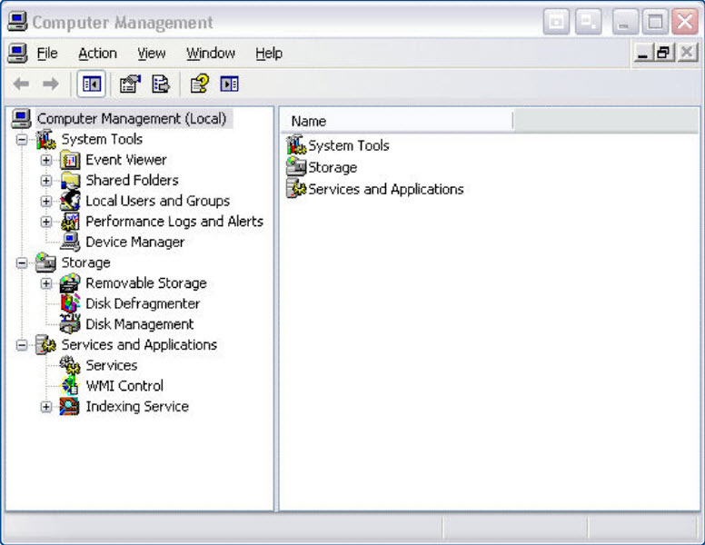
Computer Management Console
Addresses three main areas of administration:
  System Tools
  Storage
  Services and Applications
Notes:
5.5.3 Explore administrative tools
The Computer Management console allows you to manage many aspects of both your computer and remote computers. The Computer Management console addresses three main areas of administration: System Tools, Storage, and Services and Applications. You must have administrative privileges to access the Computer Management console.

Slide 36
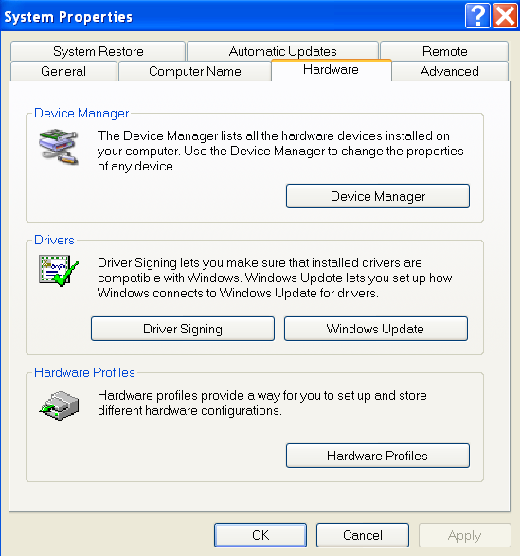
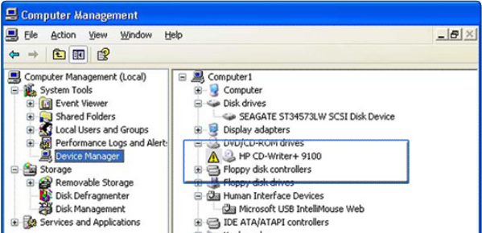
Device Manager
Used to view settings for devices in the computer
An exclamation mark indicates a problem with a device
Notes:
5.5.3 Explore administrative tools
The device manager allows you to view all of the settings for devices in the computer. A common task for technicians is to view the values assigned for the IRQ, I/O addresses, and the DMA setting for all of the devices in the computer.
From the Device Manager, you can quickly view the properties of any device in the system by double-clicking the device name. You can view which version of the driver is installed in your computer, view driver file details, update a driver, or even roll back or uninstall a device driver. You can compare the driver version listed here with the version available from the website of your device manufacturer.

Slide 37
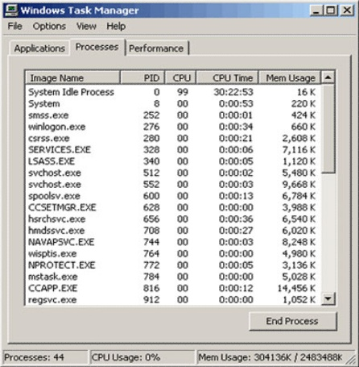
Task Manager
View all applications that are currently running
Close any applications that have stopped responding
Monitor the performance of the CPU and virtual memory
View all processes that are currently running
View information about the network connections
Notes:
5.5.3 Explore administrative tools
The Task Manager allows you to view all applications that are currently running and to close any applications that have stopped responding. The Task Manager allows you to monitor the performance of the CPU and virtual memory, view all processes that are currently running, and view information about the network connections.

Slide 38
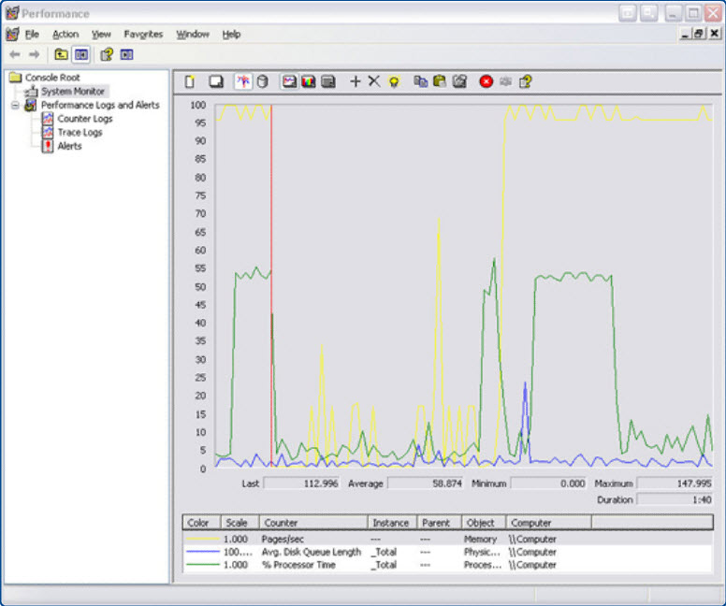
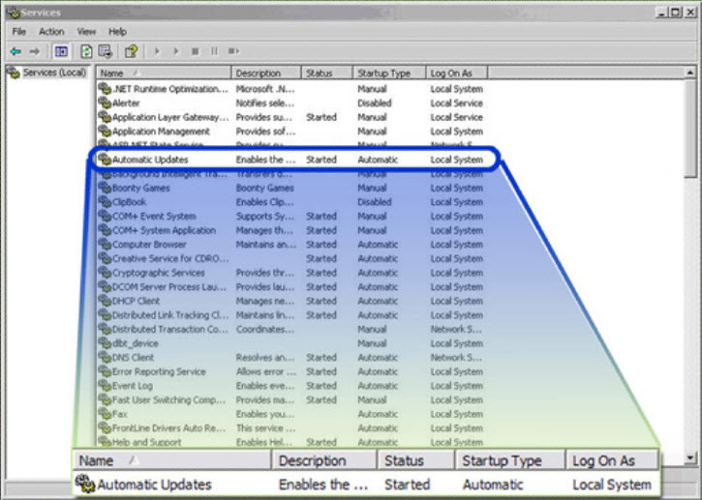
Services and Performance Monitor
You can start, stop, or disable services.
You can record performance data and configure alerts.
Notes:
5.5.3 Explore administrative tools
Services
Services are executable programs that require little or no user input. Services can be set to run automatically when Windows starts, or manually when required. The Services console allows you to manage all of the services on your computer and remote computers. You can start, stop, or disable services. You can also change how a service starts, or define actions for the computer to perform automatically when a service fails. You must have administrative privileges to access the Services console.
Performance Monitor
The Performance Monitor console has two distinct parts: the System Monitor and Performance Logs and Alerts. The System Monitor displays real-time information about the processors, disks, memory, and network usage for your computer. You can easily summarize these activities through histograms, graphs, and reports.
Performance Logs and Alerts allow you to record the performance data and configure alerts. The alerts will notify you when a specified usage falls below or rises above a specified threshold. You can set alerts to create entries in the event log, send a network message, begin a performance log, run a specific program, or any combination of these. You must have administrative privileges to access the Performance Monitor console.

Slide 39
Event Viewer and Remote Desktop
Event Viewer
Logs a history of events regarding applications, security, and the system.
These log files are a valuable troubleshooting tool.
Remote Desktop
Allows one computer to remotely take control of another computer.
In Windows XP, this troubleshooting feature is only available with Windows XP Professional.
Notes:
5.5.3 Explore administrative tools
The Event Viewer logs a history of events regarding applications, security, and the system. These log files are a valuable troubleshooting tool.
The Remote Desktop allows one computer to remotely take control of another computer. Remote technicians can use this troubleshooting feature to repair and upgrade computers. For Windows XP, Remote Desktop is available on Windows XP Professional only.

Slide 40
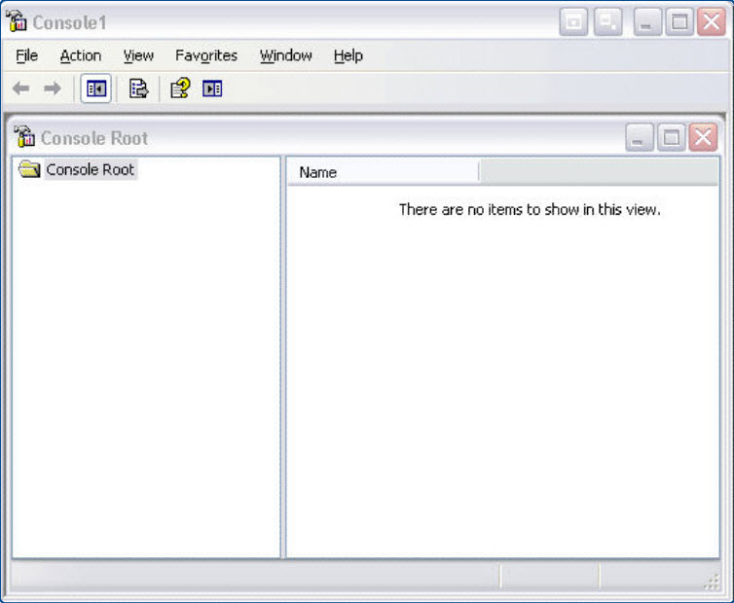
Microsoft Management Console
MMC allows you to organize management tools, called snap-ins, in one location for easy administration.
Add to MMC
  Web page links
  Tasks
  ActiveX controls
  Folders
Notes:
5.5.3 Explore administrative tools
MMC
The Microsoft Management console (MMC) allows you to organize management tools, called snap-ins, in one location for easy administration. Web page links, tasks, ActiveX controls, and folders can also be added to the MMC. After you have configured an MMC, save it to keep all the tools and links in that MMC. You can create as many customized MMCs as needed, each with a different name. This is useful when multiple administrators manage different aspects of the same computer. Each administrator can have an individualized MMC for monitoring and configuring computer settings. You must have administrative privileges to access the MMC.

Slide 41
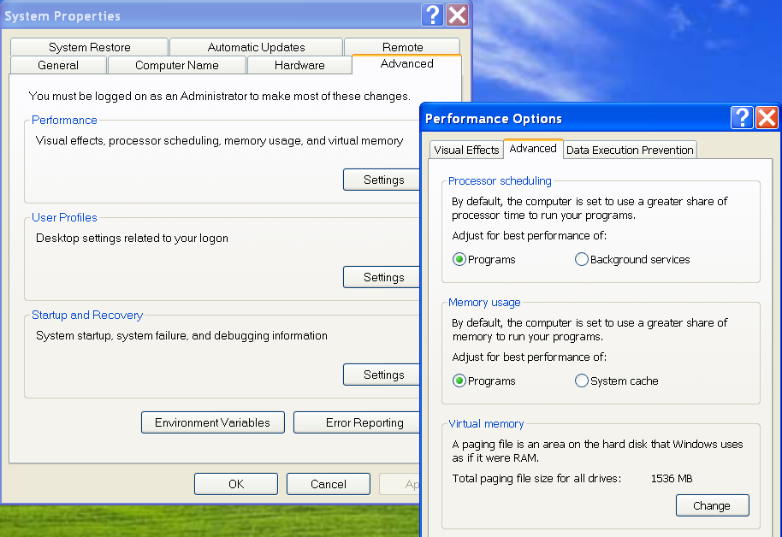
Performance Settings
Settings for advanced visuals and for virtual memory
Notes:
5.5.3 Explore administrative tools
To enhance the performance of the operating system, you can change some of the settings that your computer uses, such as virtual memory configuration settings.
There are many different settings that can be configured in the Windows operating system. These settings can all be accessed through the Control Panel.
Student Activity: The student course content includes two labs:
5.5.3 Lab: Managing Administrative Setting and Snap-ins in Windows XP. To complete this lab, students will monitor system resources and build a custom console. The following equipment is required for this exercise: a computer system running Windows XP and Internet access.
5.5.3 Lab: Managing Administrative Setting and Snap-ins in Windows Vista. To complete this lab, students will monitor system resources and build a custom console. The following equipment is required for this exercise: a computer system running Windows Vista and Internet access.
Note: The Windows Vista labs include information covered in the CompTIA A+ certification and IT Essentials course chapter and final exams. These labs must be completed to prepare for the certification and course chapter and final exams. If the class does not have access to the Windows Vista operating system and compatible computer equipment, students must complete the labs using the provided screenshots.

Slide 42
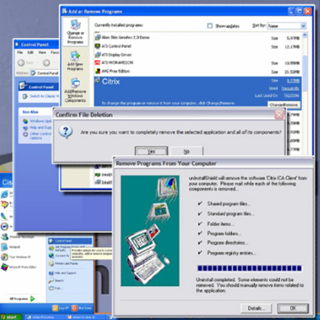
Add or Remove an Application
Utility to install or uninstall applications
Tracks installation files for future thorough uninstall, if desired
Notes:
5.5.4 Install, navigate, and uninstall an application
Add or Remove Programs Applet
Microsoft recommends that users always use the Add or Remove Programs utility, when installing or removing applications. When you use the Add or Remove Programs utility to install an application, the utility tracks installation files so that the application can be uninstalled completely, if desired.
Add an Application
If a program or application is not automatically installed when the CD is inserted, you can use the Add or Remove Programs applet to install the application. Click on the Add New Programs button and select the location where the application is located. Windows will install the application for you.
Once the application is installed, the application can be started from the Start menu or a shortcut icon that the application installs on the desktop. Check the application to ensure that it is functioning properly. If there are problems with the application, make the repair or uninstall the application. Some applications, such as Microsoft Office, provide a repair option in the install process. You can use this function to try to correct a program that is not working properly.
Uninstall an Application
If an application is not uninstalled properly, you may be leaving files on the hard drive and unnecessary settings in the registry. Use the Add or Remove Programs applet to uninstall programs that you no longer need. The wizard will guide you through the software removal process and remove everything that was installed.
Student Activity: The student course content includes two labs:
5.5.4 Lab: Install Third-Party Software in Windows XP. To complete this lab, students will install and remove a third party software application by using the Microsoft Windows XP Professional Installation CD. Students will install the CITRIX ICA 32-bit Windows Client application. The following equipment is required for this exercise; a computer system that is using Windows XP and a Microsoft Windows XP installation CD.
5.5.4 Lab: Install Third-Party Software in Windows Vista. To complete this lab, students will install the CITRIX ICA 32-bit Windows Client application. The following equipment is required for this exercise; a computer system that is using Windows Vista and a flash drive or CD with CITRIX ICA 32-bit Windows install package.
Note: The Windows Vista labs include information covered in the CompTIA A+ certification and IT Essentials course chapter and final exams. These labs must be completed to prepare for the certification and course chapter and final exams. If the class does not have access to the Windows Vista operating system and compatible computer equipment, students must complete the labs using the provided screenshots.

Slide 43
Upgrading to Windows XP
Insert the Windows XP CD. Select Start > Run.
In the Run box, where D is the drive letter for the CD-ROM, type D:\i386\winnt32 and press Enter. The Welcome to the Windows XP Setup Wizard displays.
Choose Upgrade to Windows XP and click Next. The License Agreement page displays.
Read the license agreement and click the button to accept this agreement.
Click Next.
Follow the prompts and complete the upgrade. When the install is complete, the computer will restart.
Notes:
5.5.5 Describe upgrading an operating system
Sometimes it may be necessary to upgrade an operating system. Before upgrading the operating system, check the minimum requirements of the new operating system to ensure that the computer meets the minimum specifications required. You should also check the HCL to ensure that the hardware is compatible with the operating system. Back up all data before upgrading the operating system in case there is a problem with the installation.

Slide 44
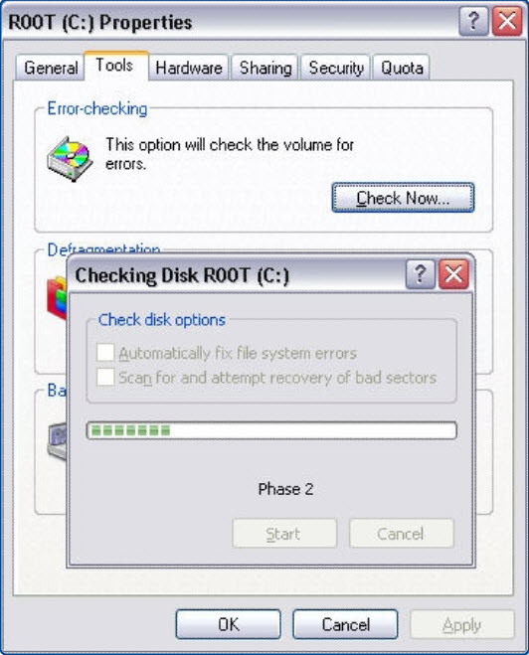
Preventive Maintenance Planning
Components of a preventive maintenance plan:
Updates to the operating system and applications
Updates to anti-virus and other protective software
Hard drive error checking
Hard drive backup
Hard drive defragmentation
Device drive updates
Firmware updates
Startup programs
Notes:
5.6 Identify and apply common preventive maintenance techniques for operating systems
After completing this section, you will meet these objectives:
Create a preventive maintenance plan.
Schedule a task.
Back up the hard drive.
5.6.1 Create a preventive maintenance plan
The goal of an operating system preventive maintenance plan is to avoid problems in the future. You should perform preventive maintenance regularly, and you should also record all actions taken and observations made. Some preventative maintenance should take place when it will cause the least amount of disruption to the people who use the computers. This often means scheduling tasks at night, early in the morning, or over the weekend. There are tools and techniques that can automate many preventive maintenance tasks.
Preventive maintenance plans should include detailed information about the maintenance of all computers and network equipment, with emphasis on equipment that could impact the organization the most.
An additional part of preventive maintenance is documentation. A repair log will help you to figure out which equipment is the most or least reliable. It will also provide a history of when a computer was last fixed, how it was fixed, and what the problem was.
Device Driver Updates
Check for updated drivers when your hardware does not work properly or to prevent future problems. It is also important to update drivers that patch or correct security problems.
Firmware Updates
Firmware updates can increase the speed of certain types of hardware, enable new features, or increase the stability of a product. Follow the manufacturer’s instructions carefully when performing a firmware update to avoid making the hardware unusable
Operating System Updates
You can install individual updates manually from the Microsoft website or automatically using the Windows Automatic Update utility. A service pack usually contains all of the updates for an operating system. Installing a service pack is a good way to bring your operating system up to date quickly.
Security
Install virus and malware protection software and perform regular scans on your computer to help ensure that your computer remains free of malicious software
Startup Programs
Some programs, such as antivirus scanners and spyware removal tools, do not automatically start when the computer boots up. To ensure that these programs run each time the computer is booted, add the program to the Startup folder of the Start menu.

Slide 45
Schedule Tasks
The DOS AT command launches tasks at a specified time using the command line interface.
The Windows Task Scheduler launches tasks at a specified time using a graphical interface.
Both of these tools allow users to set commands to run at a certain time just once, or to repeat at selected days or times.
Notes:
5.6.2 Schedule a task
Some preventive maintenance consists of cleaning, inspecting, and doing minor repairs. Some preventive maintenance uses application tools that are either already in the operating system or can be loaded onto the user's hard drive. Most preventive maintenance applications can be set to run automatically according to a schedule.
Two utilities that are useful tools for preventive maintenance are:
ScanDisk or CHKDSK - ScanDisk (Windows 2000) and CHKDSK (Windows XP and Vista) check the integrity of files and folders and scan the hard disk surface for physical errors. Consider using them at least once a month and also whenever a sudden loss of power causes the system to shut down.
Defrag - As files increase in size, some data is written to the next available space on the disk. In time, data becomes fragmented, or spread all over the hard drive. It takes time to seek each section of the data. Defrag gathers the noncontiguous data into one place, making files run faster.

Slide 46
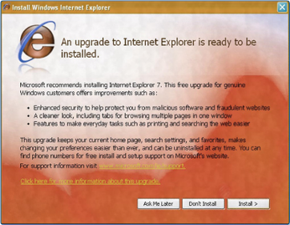
Automatic Updates
An automatic update service scans the system for needed updates, and recommends what should be downloaded and installed.
Automatic update services can setup to download and install updates as soon as they are available or as required, and install them when the computer is next rebooted.
Notes:
5.6.2 Schedule a task
Operating systems and applications are constantly being updated for security purposes and for added functionality. It is important that Microsoft and others provide an update service.
The update service can scan the system for needed updates and then recommend what should be downloaded and installed. The update service can download and install updates as soon as they are available, or it can download updates as required, and install them when the computer is next rebooted.
Most anti-virus software contains its own update facility. It can update both its application software and its database files automatically. This allows it to provide immediate protection as new threats develop.

Slide 47
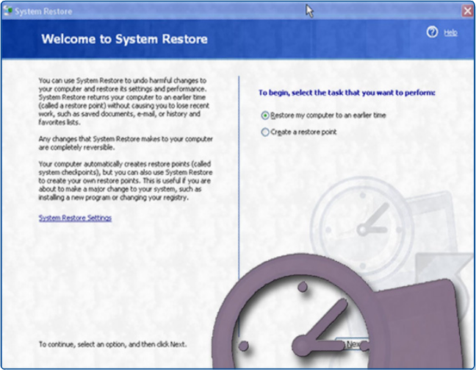
Restore Point
If the computer crashes, the OS can roll back to a restore point.
  The restore point utility only operates on OS and application files.
  Anti-virus software should be run to remove malware before creating a restore point.
When to create a restore point:
  Before updating or replacing the OS
  When an application or
  driver is installed
  Manually at any time
Notes:
5.6.2 Schedule a task
An update can sometimes causes serious problems. Perhaps an older program is in the system that is not compatible with the current operating system. An automatic update may install code that will work for most users but does not work with your system.
Windows XP can create an image of the current computer settings, called a restore point. Then, if the computer crashes, or an update causes system problems, the computer can roll back to a previous configuration.
NOTE: A restore point backs up drivers, system files, and registry settings but not application data.
A recovery CD contains the essential files used to repair the system after a serious issue, such as a hard drive crash. The recovery CD can contain the original version of Windows, hardware drivers, and application software. When the recovery CD is used, the computer will be restored to the original default configuration.
Student Activity: The student course content includes two labs:
5.6.2 Lab: Restore Point in Windows XP. To complete this lab, students will create a restore point and return the computer back to that point in time. The following equipment is required for this exercise: a computer system running Windows XP and the Windows XP installation CD.
5.6.2 Lab: Restore Points in Windows Vista. To complete this lab, students will create a restore point and return the computer back to that point in time. The following equipment is required for this exercise: a computer system running Windows Vista.
Note: The Windows Vista labs include information covered in the CompTIA A+ certification and IT Essentials course chapter and final exams. These labs must be completed to prepare for the certification and course chapter and final exams. If the class does not have access to the Windows Vista operating system and compatible computer equipment, students must complete the labs using the provided screenshots.

Slide 48
Backup the Hard Drive
Backup tools allow for recovery of data.
Use the Microsoft Backup Tool to perform backups.
Establish a backup strategy that will allow for the recovery of data.
Decide how often the data must be backed up and the type of backup to perform.
Windows XP uses Volume Shadow Copying, which allows users to continue to work even as a backup is taking place.
It is only necessary to make copies of the files that have changed since the last backup.
Notes:
5.6.3 Back up the hard drive
Just as the system restore points allow the restoration of OS configuration files, backup tools allow recovery of data. You can use the Microsoft Backup Tool to perform backups as required. It is important to establish a backup strategy that includes data recovery. The organization’s requirements will determine how often the data must be backed up and the type of backup to perform.
It can take a long time to run a backup. If the backup strategy is followed carefully, it will not be necessary to backup every file at every backup. It is only necessary to make copies of the files that have changed since the last backup. For this reason, there are several different types of backup.

Slide 49
Types of Backups
 | Description | Clear marker
Normal | Selected files and folders | Yes
Copy | Selected files and folders | No
Differential | Selected files and folders that changed since the last backup | No
Incremental | Selected files and folders that changed since the last backup | Yes
Daily | Selected files and folders that changed during the day | No
Notes:
5.6.3 Back up the hard drive
A normal backup is also called a full backup. During a normal backup, all selected files on the disk are archived to the backup medium. These files are marked as having been archived.
A copy backup will copy all selected files. It does not mark the files as having been archived.
A differential backup backs up all the files and folders that have been created or modified since the last normal backup or the last incremental backup. The differential backup does not mark the files as having been archived. Copies will be made from the same starting point until the next incremental or full backup is performed.
An incremental backup procedure backs up all the files and folders that have been created or modified since the last normal or incremental backup. It marks the files as having been archived. This has the effect of advancing the starting point of differential backups without having to re-archive the entire contents of the drive.
Daily backups only back up the files that are modified on the day of the backup. Daily backups do not mark the files as being archived.
There are many types of backup media available for computers:
Tape drives are devices that are used for data backup on a network server drive. Tape drives are an inexpensive way to store a large amount of data.
The Digital Audio Tape (DAT) tape standard uses 4 mm digital audiotapes to store data in the Digital Data Storage (DSS) format.
Digital Linear Tape (DLT) technology offers high-capacity and relatively high-speed tape backup capabilities.
USB flash memory can hold hundreds of times the data that a floppy disk can hold. USB flash memory devices are available in many capacities and offer better transfer rates than tape devices.
Optical media, such as CDs, DVDs, and Blu-ray Discs, are plastic discs used to store data. Many formats and capacities of optical media are available. A DVD holds much more data than a CD, and a Blu-ray Disc holds much more data than a DVD.
External Hard Disk Drives (HDDs) are hard drives that are connected to your computer using a USB, FireWire, or external Serial ATA (eSATA) connection. External HDDs can hold very large amounts of data and can transfer data very quickly.
Student Activity: The student course content includes the lab, 5.6.3 Registry Backup and Recovery in Windows XP. To complete this lab, students will back up a computer registry and perform a recovery of a computer registry. The following equipment is required for this exercise; a computer system running Windows XP.

Slide 50
Troubleshooting Process
Step 1 Identify the problem
Step 2 Establish a theory of probable causes
Step 3 Determine an exact cause
Step 4 Implement a solution
Step 5 Verify solution and full system functionality
Step 6 Document findings
Notes:
5.7 Troubleshoot operating systems
Most operating systems contain utilities to assist in the troubleshooting process. These utilities help a technician to determine why the computer crashes or does not boot properly. The utilities also help identify the problem and how to resolve it.

Slide 51
Step 1 - Identify the Problem
Computer configuration
  Operating system, patches and updates, network environment, connection type
Open-ended questions
  What problems are you experiencing with your computer?
  What software has been installed on your computer recently?
  What were you doing when the problem was identified?
  What operating system do you have installed on your computer?
  What updates or patches have been installed on your computer?
Closed-ended questions
  Has anyone else used your computer recently?
  Does the computer boot up successfully?
  Have you changed your password recently?
  Have you received any error messages on your computer?
Notes:
5.7.1 Review the troubleshooting process
Identify the Problem
When a customer is not able to accurately describe the problem, there are other ways to evaluate the situation in subsequent steps in the troubleshooting process.

Slide 52
Step 2 - Establish a Theory of Probable Causes
Create a list of the most common reasons why the error would occur and list the easiest or most obvious causes at the top with the more complex causes at the bottom.
  Incorrect settings in BIOS
  Caps lock key is set to ON
  Non-bootable media in the floppy drive during computer boot up
  Password has changed
  Incorrect monitor settings in control panel
  Operating system update failure
  Driver update failure
  Malware infection
  Hard drive failure
  Corrupt operating system files
Notes:
5.7.1 Review the troubleshooting process
Establish a Theory of Probable Causes

Slide 53
Step 3 - Determine the Exact Cause
Testing your theories of probable causes one at a time, starting with the quickest and easiest.
  Log in as a different user.
  Use third party diagnostic software.
  New software or software updates have just been installed.
  Uninstall recently installed applications.
  Boot into safe mode to determine if the problem is driver-related.
  Roll back newly updated drivers.
  Examine Device Manager for device conflicts.
  Examine event logs for warnings or errors.
  Check the hard drive for errors and fix file system issues.
  Use the system file checker to recover corrupt system files.
  Use system restore if a system update or service pack has been installed.
Notes:
5.7.1 Review the troubleshooting process
Determine the Exact Cause
If the exact cause of the problem has not been determined after you have tested all your theories, establish a new theory of probable causes and test it.

Slide 54
Step 4 - Implement a Solution
If a quick procedure does not correct the problem, you might need to research the problem further to establish the exact cause.
Divide larger problems into smaller problems that can be analyzed and solved individually.
Create a list of possible solutions and implement them one at a time. If you implement a possible solution and it does not work, reverse the solution and try another.
Notes:
5.7.1 Review the troubleshooting process
Implement a Solution
If a quick procedure does correct the problem, you can go to step 5 to verify the solution and full system functionality.
Evaluate the problem and research possible solutions. Divide larger problems into smaller problems that can be analyzed and solved individually. Prioritize solutions starting with the easiest and fastest to implement.
Check:
Helpdesk repair logs
Other techs
Manufacturer FAQs
Technical websites’
News groups
Computer manuals
Device manuals
Online forums
Internet search

Slide 55
Step 5 - Verify Solution and System Functionality
Verifying full system functionality and implementing any preventive measures if needed.
  Shut down the computer and restart it.
  Check event logs to make sure there are no new warnings or errors.
  Check Device Manager to see that there are no warnings or errors.
  Run DxDiag to make sure DirectX is running correctly.
  Make sure applications run properly.
  Make sure network shares are accessible.
  Make sure the Internet can be accessed.
  Re-run system file checker to ensure all files are correct.
  Re-run scandisk to make sure no problems remain on the hard drive.
  Check task manager to ensure no programs are running incorrectly.
  Re-run any third party diagnostic tools.
Have the customer verify the solution and system functionality.
Notes:
5.7.1 Review the troubleshooting process
Verify Solution and System Functionality

Slide 56
Step 6 - Document Findings
Discuss the solution with the customer
Have the customer confirm that the problem has been solved
Give the customer all appropriate paperwork
Document the process in the work order and in your technician’s journal:
  Problem description
  Solution
  Components used
  Amount of time spent in solving the problem
Notes:
5.7.1 Review the troubleshooting process
Document Findings

Slide 57
Common Problems and Solutions
Operating system problems can be attributed to hardware, application, or configuration issues, or to some combination of the three. You will resolve some types of operating system problems more often than others.
Notes:
5.7.2 Identify common problems and solutions
[Direct the students to the curriculum to see all the charts explaining more common problems and solutions]
Student Activity: The student course content includes two labs:
5.7.2 Lab: Managing Device Drivers with Device Manager in Windows XP. To complete this lab, students will manage device drivers. The following equipment is required for this exercise; a computer system running Windows XP.
5.7.2 Lab: Managing Device Drivers with Device Manager in Windows Vista. To complete this lab, students will manage device drivers. The following equipment is required for this exercise; a computer system running Windows Vista.
Note: The Windows Vista labs include information covered in the CompTIA A+ certification and IT Essentials course chapter and final exams. These labs must be completed to prepare for the certification and course chapter and final exams. If the class does not have access to the Windows Vista operating system and compatible computer equipment, students must complete the labs using the provided screenshots.

Slide 58
Chapter 5 Summary
Several different operating systems are available, and you must consider the customer's needs and environment when choosing an operating system.
The main steps in setting up a customer's computer include preparing the hard drive, installing an operating system, creating user accounts, and configuring installation options.
A GUI shows icons of all files, folders, and applications on the computer. A pointing device, such as a mouse, is used to navigate in a GUI desktop.
You should establish a backup strategy that allows for the recovery of data. Normal, copy, differential, incremental, and daily backups are all optional backup tools available in Windows operating systems.
Preventive maintenance techniques help to ensure optimal operation of the operating system.
Some of the tools available for troubleshooting an operating system problem include Windows Advanced Options menu, event logs, device manager, and system files.
Notes:
Chapter 5 Summary
This chapter introduced computer operating systems. A technician should be skilled at installing, configuring, and troubleshooting an operating system.

Slide 59


